Slide 1
UW–Madison Faculty and Staff Pay Adjustments
Fiscal Year 18

Slide 2
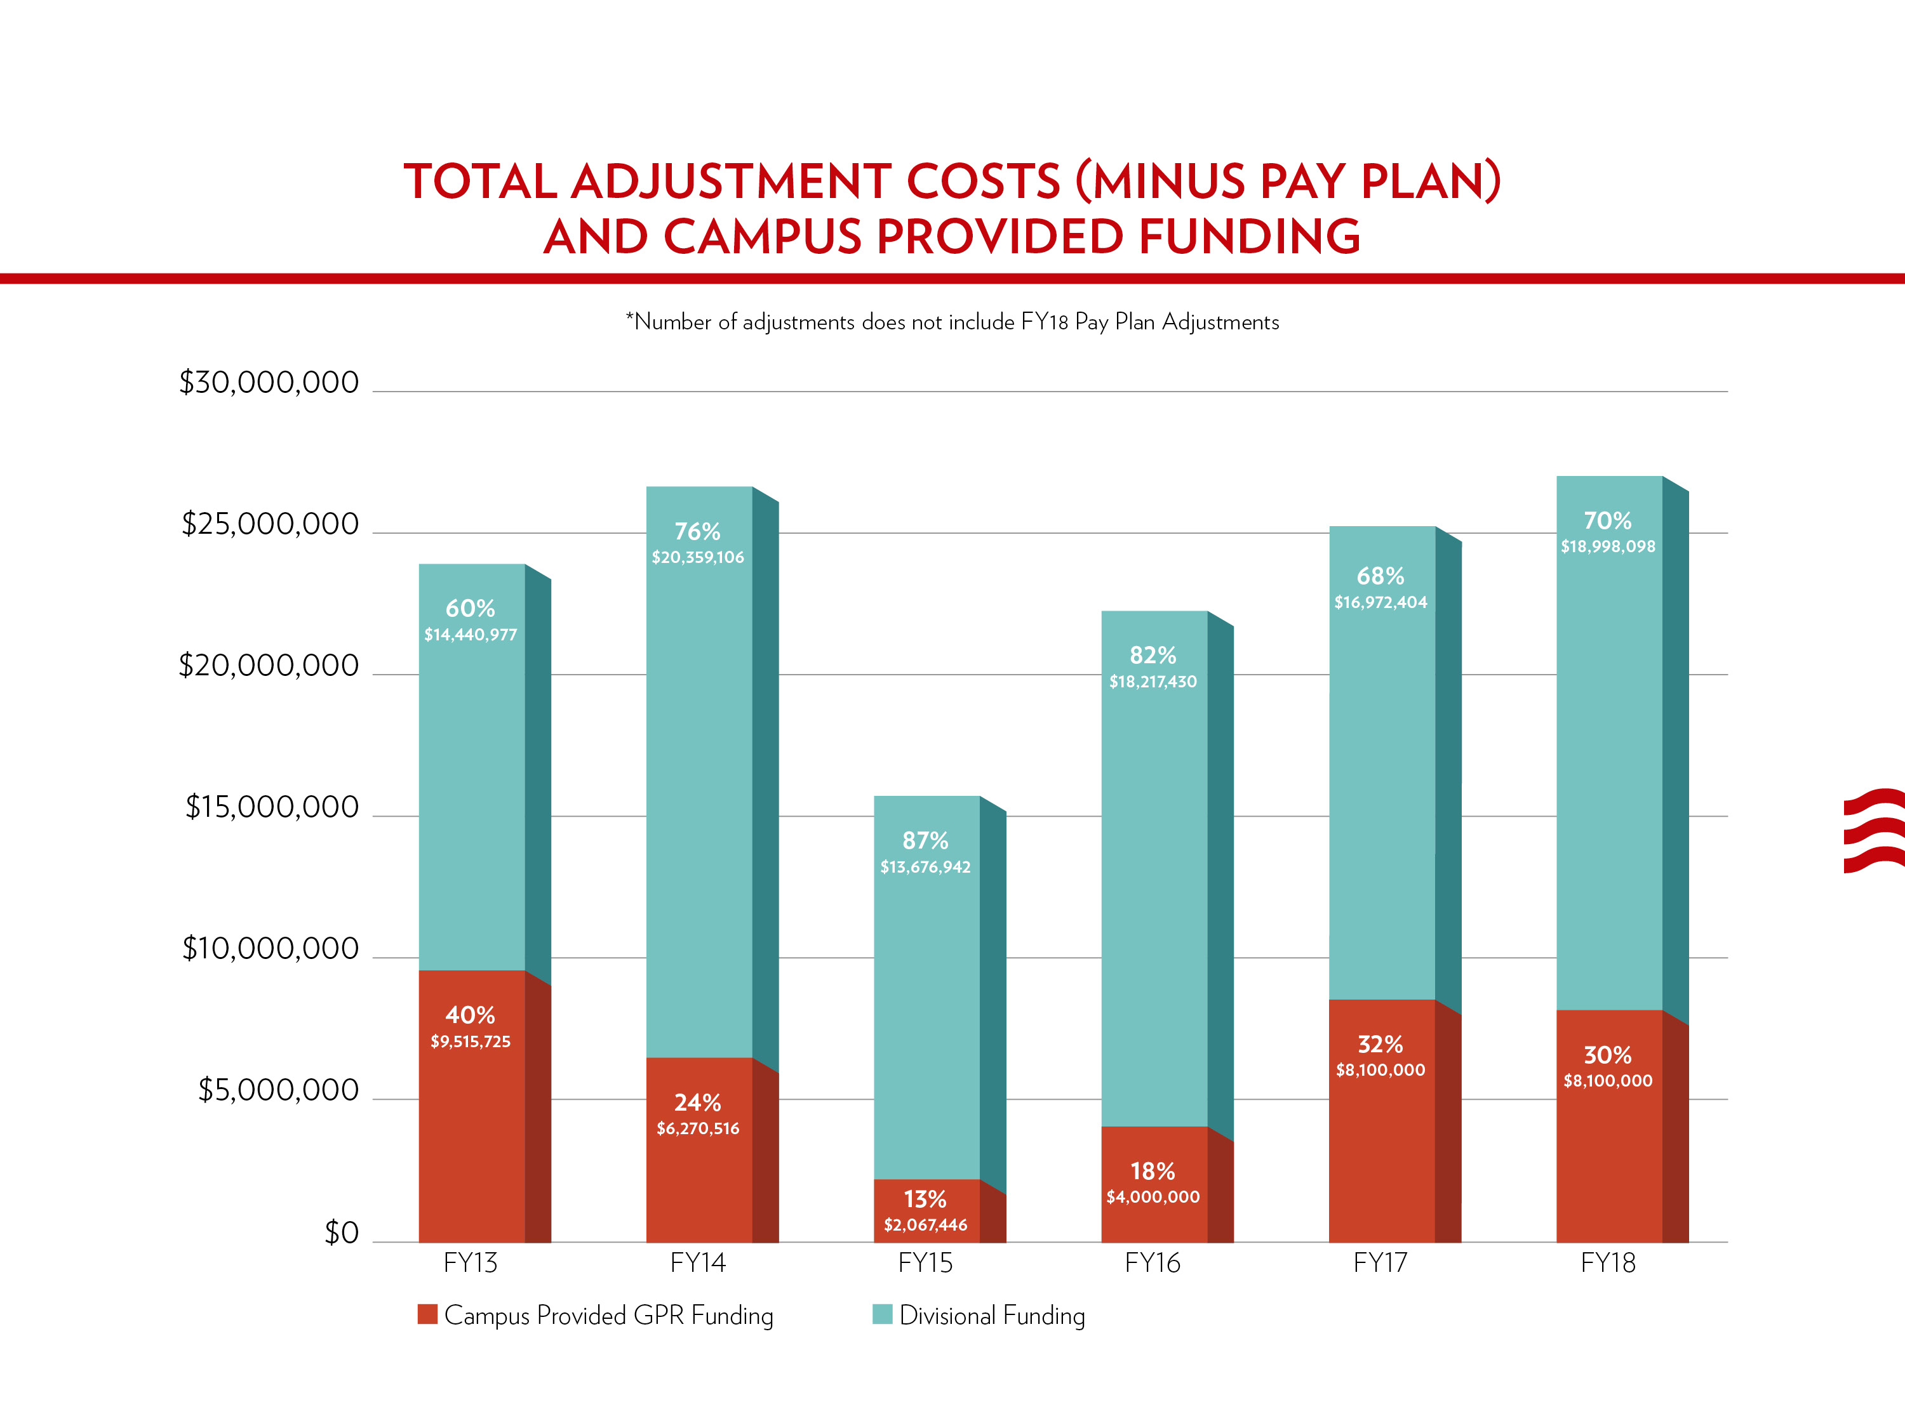

Slide 3
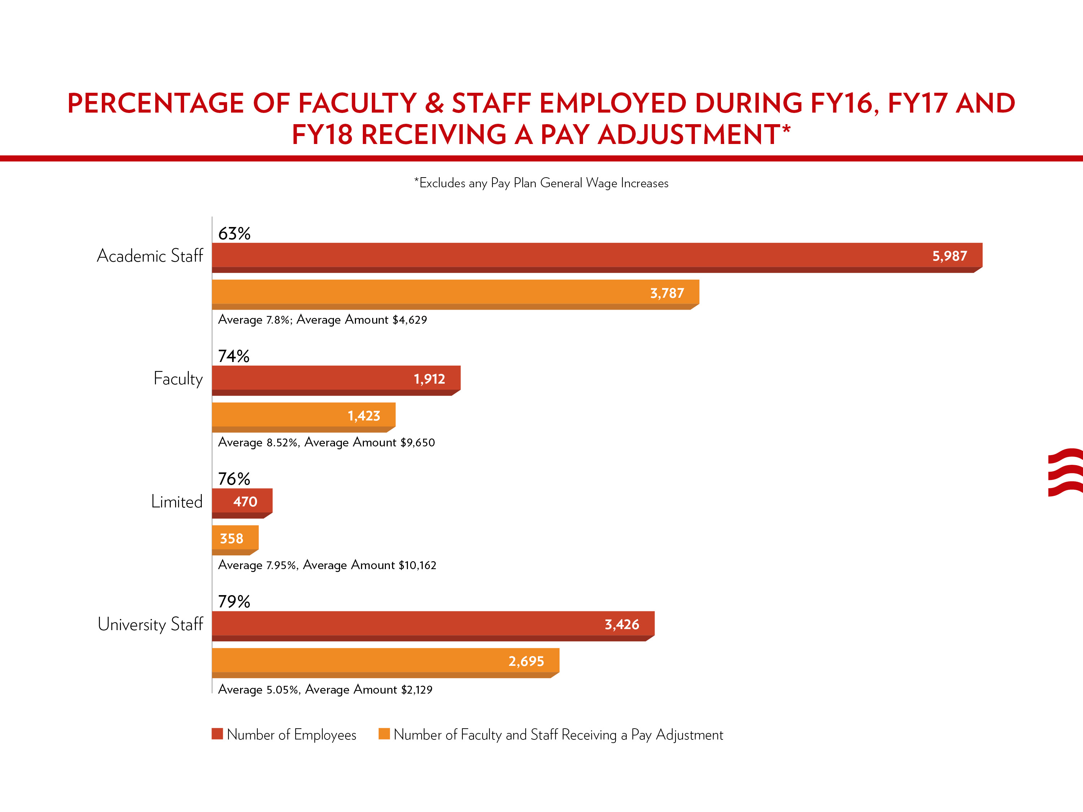

Slide 5
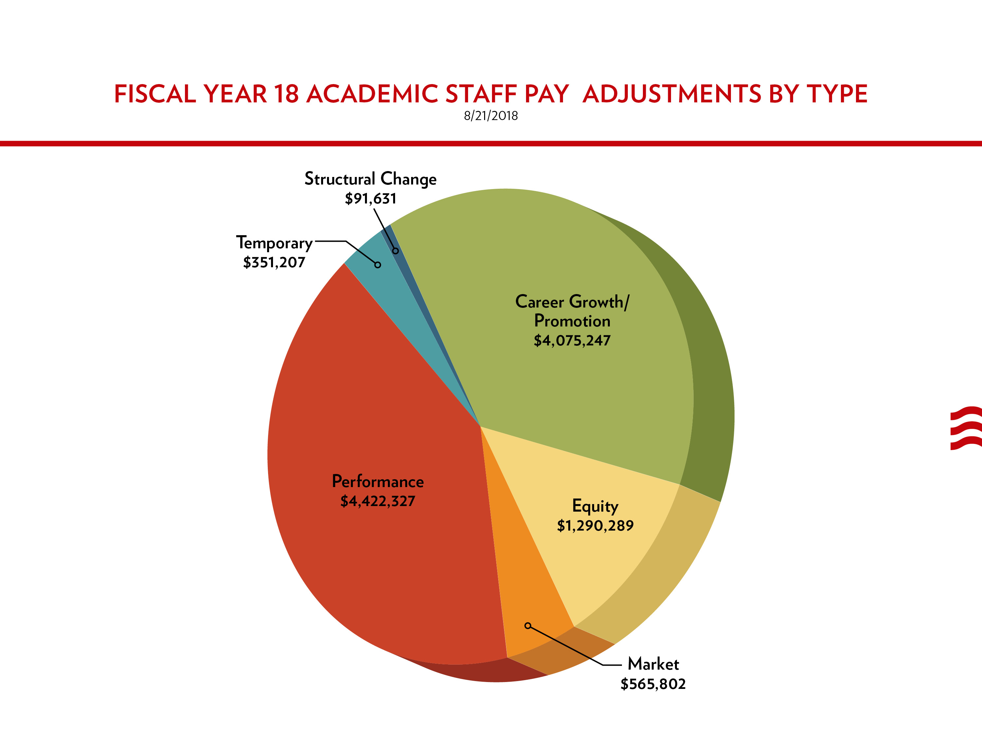

Slide 6
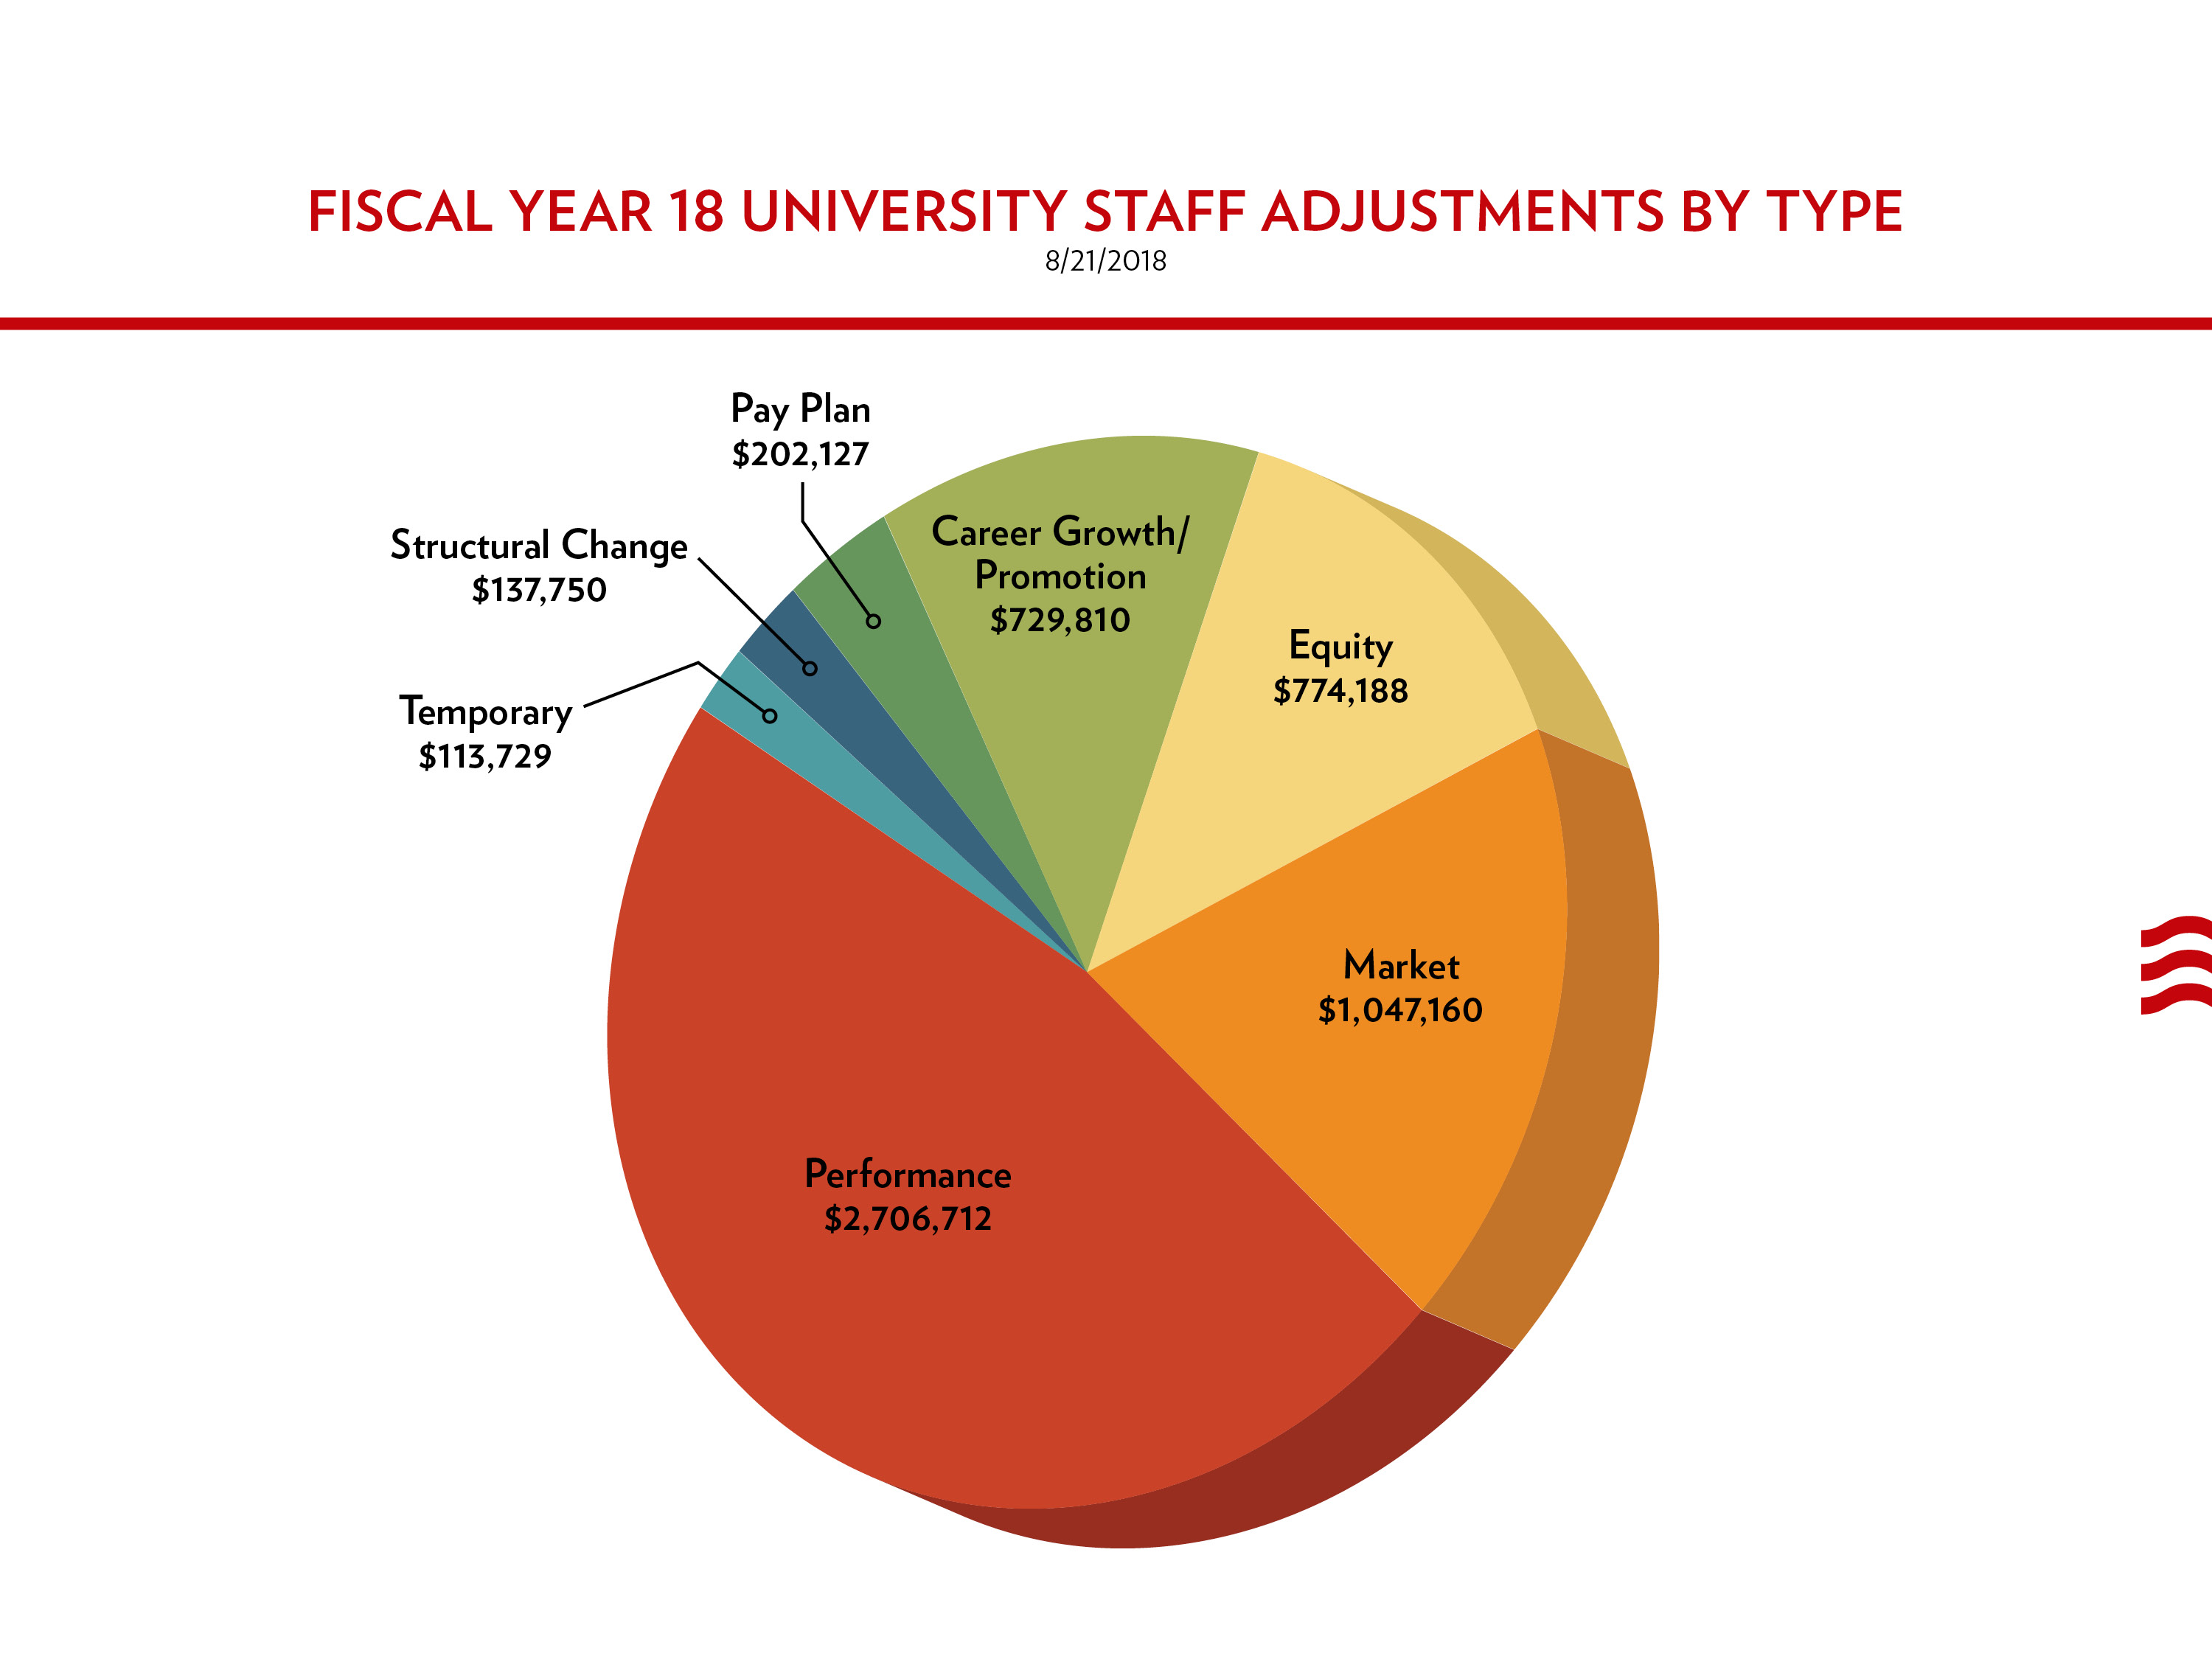

Slide 7
Pay Adjustment Amount Summary (FY18)
Summary of Fiscal Year 18 Pay Adjustments
Adjustment Type | Academic Staff | Faculty | Limited | University Staff | Grand Total | Percent of Total
Career Growth/Promotion | $4,075,247 | $1,204,785 | $257,128 | $729,810 | $6,266,969 | 22.96%
Equity | $1,290,289 | $682,113 | $269,715 | $774,188 | $3,016,306 | 11.05%
Market | $565,802 | $3,949,118 | $1,108,838 | $1,047,160 | $6,670,918 | 24.44%
Pay Plan |  |  |  | $202,127 | $202,127 | 0.74%
Performance | $4,422,327 | $1,492,474 | $1,141,902 | $2,706,712 | $9,763,415 | 35.76%
Structural Change | $91,631 | $4,981 |  | $137,750 | $234,362 | 0.86%
Temporary | $351,207 | $523,123 | $158,069 | $113,729 | $1,146,128 | 4.20%
Grand Total | $10,796,503 | $7,856,593 | $2,935,652 | $5,711,477 | $27,300,225 | 100.00%
March 2018 Payroll | $529,041,585 | $258,849,557 | $75,138,564 | $211,675,874 | $1,074,705,580
Percent of March 2018 Payroll | 2.04% | 3.04% | 3.91% | 2.70% | 2.54% | 8/21/2018

Slide 9
