Slide 1
Title and Total Compensation Project (TTC)
Academic Staff Assembly
February 10, 2020
Mark Walters, Chief Human Resource Officer
Diane Blaskowski, Talent Rewards Director

Slide 2
TTC Project Timeline
SEP
OCT
NOV
DEC
JAN
FEB
MAR
APR
MAY
JUN
JUL
AUG
SEP
TTC QA: SJD Consistency, Review mapping
(Phases I & II)
TTC QA: Ongoing (Phase III)
Long-term Compensation
Implementation Strategy
Standardized Job Titling and Comp Structure
Compensation/Title Structure Finalization
Employee Mapping w/ Division HR
Letter Notification
SJD Library Posted
HR Training
Manager Training
Campus
Partnership
Employee/Manager Engagement
Title/SJD Appeals Process
Employee
OHR
Employee Communications & Training Offering
Salary Structure Training
Campus Forums
Campus Forums
Campus Forums
Benefits
Review and Evaluate Benefits Strategy
Develop Benefits Recommendations
Benefits Implementation Strategy

Slide 3
Key Dates – Timeline Shift
February 2020
Complete Quality Assurance (QA) phases I & II
April 2020
Employee Conversations conclude (part of QA phase III)
May 2020
Salary structure available
Notification letters sent to staff (translated copies available)
Appeals process begins
July 1, 2020
New titles and salary structure go into effect

Slide 4
QA Goals
Create consistent mapping across campus:
  Hold divisional alignment sessions
  Identify trends, outliers and evaluate for accuracy
  Review mapping by job groups (e.g. leadership)
  Address manager and employee concerns
Standardize the Title and Standard Job Description (SJD) Library:
  Align job summaries with essential duties
  Confirm each jobs has appropriate Fair Labor Standards Act (FLSA) status
  Identify gaps

Slide 5
QA Updates
February 2020:
  Today, 65 percent of QA is complete
  Goal: all employees have QA Complete status
  Employee conversations for all titles can begin
March 1, 2020:
  Updates to existing SJDs will be finalized
April 30, 2020:
  All employee conversations and position descriptions will be complete

Slide 6
Employee Conversations
Goal:
Confirm that new titles and position descriptions accurately describe the work employees do
Conversations Include
Conversations Do Not Include
New official job title
New business title/working title
New position description
Next steps
Salary range of new title
Changes to benefits package
Note: Employees can still appeal their title after having a conversation

Slide 7

Conversations
  All Conversations:
  Provide an opportunity for employees to ask questions
  Conclude by April 30, 2020
  Formats Vary Across Campus:
  Could occur in a group or one-on-one
  Led by HR or managers
  May include multiple conversations

Slide 8
Managers Prepare for Conversations
Online Manager Training:
Describes the manager role in TTC Project
1,444 have registered or completed training
Manager Conversation Practice (Supplemental):
Prepares managers for employee conversations
Focuses on listening and responding to employees
More than 50 in-person sessions available through April

Slide 9

February Forums
Topics:
Learn about the updated project timeline
Find out about progression and promotion
Get information about official title notification letters and appeals
Bring your questions

Slide 10
February All-Campus Forums
Dates | Location | Event Time
2/11/2020 | Gordon Dining & Event Center (Multilingual)/Daytime | 1:30 – 3 p.m.
2/12/2020 | Gordon Dining & Event Center (English Only)/Daytime | 1– 2:30 p.m.
2/12/2020 | Health Sciences Learning Center (Multilingual)/Late Night | 11 p.m.– 12:30 a.m.
2/17/2020 | Gordon Dining & Event Center (English Only)/Daytime | 1– 2:30 p.m.
2/18/2020 | Health Sciences Learning Center (English Only)/Daytime | 1– 2:30 p.m.
Notes:
MBG

Slide 11
February All-Campus Forums
Dates | Location | Event Time
2/19/2020 | Memorial Union (English Only)/Daytime | 9 – 10:30 a.m.
2/20/2020 | Health Science Learning Center (English Only)/Daytime | 10:30 a.m. – 12 p.m.
2/26/2020 | Online Forum (English Only)/Daytime | 11 a.m. – 12:30 p.m.
Notes:
MBG

Slide 12
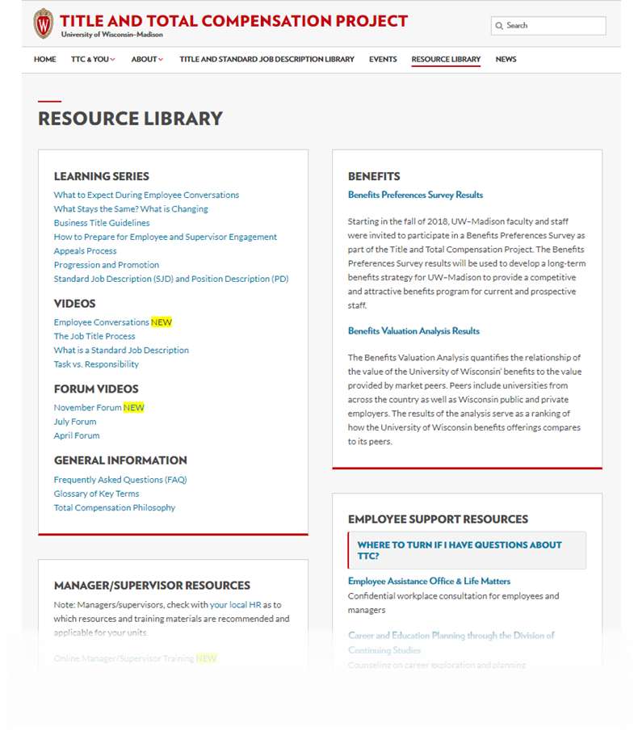
Learning Opportunities & Resources
Fact sheets
Learning series
Videos
Frequently Asked Questions
Online modules

Slide 13
Where To Turn?
Employee Assistance Office & LifeMatters
Confidential workplace consultation for employees and managers
Career and Education Planning through the Division of Continuing Studies
Counseling on career exploration and planning
Ombuds Office
Confidential guidance on workplace concerns
Professional Development courses
Courses on communication and managing change

Slide 14

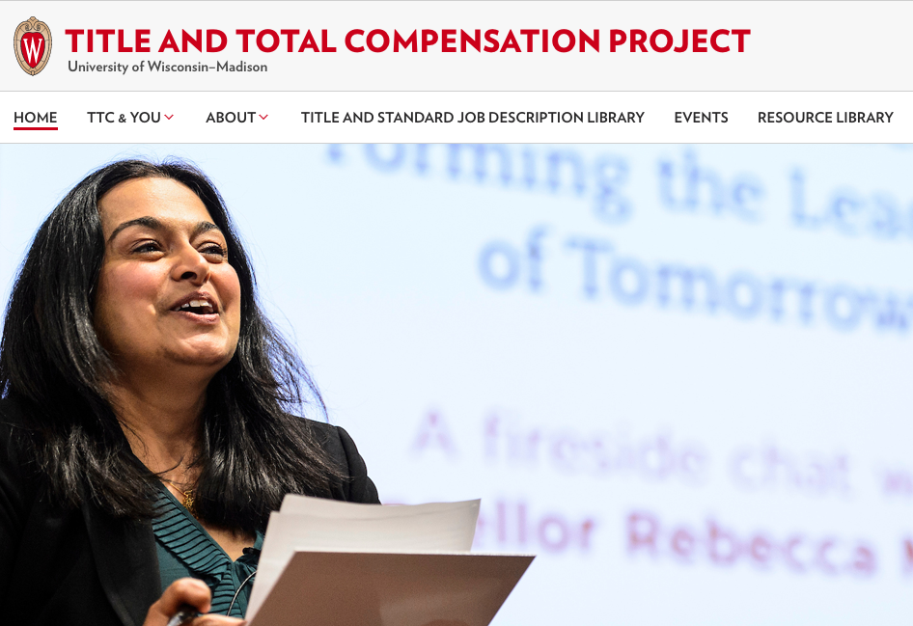
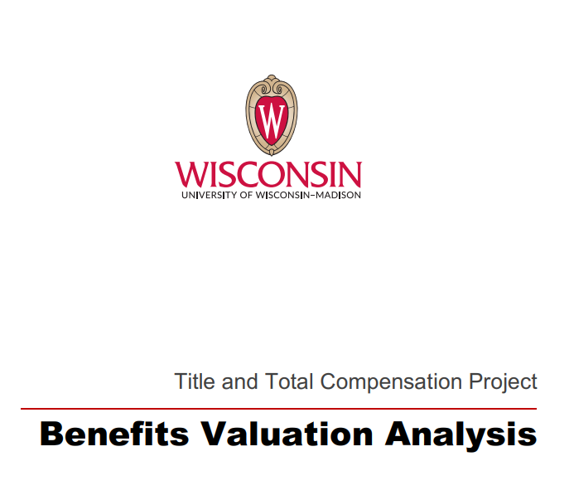
Benefits Summary Reports: Online
hr.wisc.edu/title-and-total-compensation-study/resources/

Slide 15
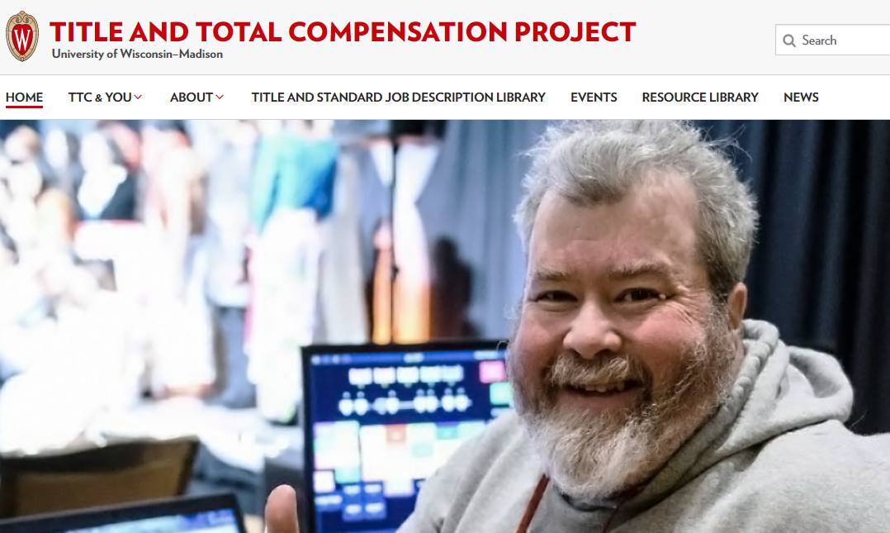
TTC Project Website
go.wisc.edu/TTCProject

Slide 16

Questions
Website:
go.wisc.edu/ttcproject
Email:
ttcstudy@ohr.wisc.edu

