Slide 1
Canvas Transition Project Overview
Brian McNurlen, DoIT Academic Technology
Elizabeth Harris, College of Engineering & UW Madison Moodle Service

Slide 2
Background
Move to Canvas is part of a larger strategy to assume control of our own data and T&L tools
Tools that adhere to standards
Interoperable with other tools and systems
Further develop student digital ecosystem
Satisfy strong student desire for one LMS
Discontinue campus support for D2L and Moodle by Summer 2018
Notes:
Why Canvas, why now?
Part of our involvement in a consortium of 11 other like-minded R-1 Universities as part of the Unizin consortium

Slide 3
Fall 2016 Stats
All credit-based course shells available in Canvas
Accessible through Learn@UW Course Dashboard
Over 650 credit-based courses published
18,950 students impacted
Notes:
Canvas now fully integrated with the student information system
To date, over 650 courses are using Canvas for the fall semester
Engaging…
18, 950 students
742 faculty and instructional staff

Slide 4
Credit Course Transition Guiding Principles
Transparent, inclusive, and collaborative processes with review and approval workflows that allow project teams to meet deadlines.
All courses that are currently making use of D2L and Moodle are able to meet their instructional goals through the use of Canvas.
Placing focus on effective pedagogical principles, understanding the paradox of transitioning to a new LMS is to use the opportunity to place greater focus on the teaching practice itself and improve course design from the bottom up in order to create an improved learner experience, while still remaining sensitive to faculty time and investment.
We will follow an adaptive strategy for providing support, continuing to evaluate the use of our support options, both in terms of what is made available to campus generally and what individual SCID's are using. With new information, we may need to adapt and change course.

Slide 5
Groups to Keep Informed
Canvas Credit Transition
Engagement Structure*
LTI-TAG
Learn@UW Madison Executive Committee
Sponsors
Steve Cramer, Bruce Maas, John Krogman, Linda Jorn
Faculty Senate
Academic Staff Assembly
Concept Owners: Brian McNurlen, Elizabeth Harris
UCAAA
Instructional Technologists Group (ITG)
TLT-MAG
TLT-MAG
Support Sub-Group
ITC
Engaged with Schools and Colleges through Associate Deans (UCAAA) and Instructional Technologists (ITG)
Engaged with Faculty (TLT-MAG, UCAAA), IT Staff (ITC), Students (ITC sub group), and Instructional Staff (ITG)
All Schools and Colleges have Canvas point people who are members of the ITG
Conducted a needs assessment in which 100% of Schools and Colleges Participated
Working with Schools and Colleges to create a transition support model and service that will meet as many needs as possible
*This chart will change as new IT Governance Structure is implemented

Slide 6
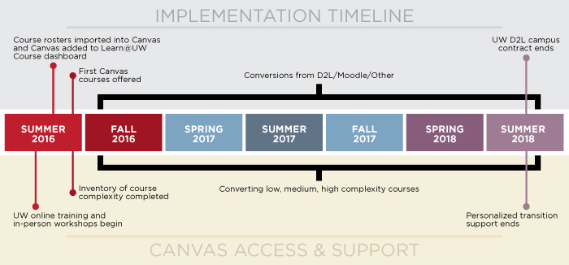
Credit Course Transition Timeline

Slide 7
Estimated Number of Course Migrations per Semester
Additional Course adoption above estimate
Note: There are fewer courses this semester but they are expected to include the most complex

Slide 8
Proposal for Canvas Credit Course Campus Support
Fall 2016 | Spring 2017 | Summer 2017 | Fall 2017 | Spring 2018 | Summer 2018
General Campus Support and Training (offered across all semesters to everyone)
SCID-Targeted Support and Training
Pilot SCIDs | SMPH LAW WSB CALS SoHE L&S: Chem L&S: Poli Sci L&S: Econ | Ad-hoc course development work | Engineering Education Vet Med Nelson Inst. Pharmacy Nursing L&S Depts. | SMPH L&S: Physics L&S: Math L&S: Philosophy | Ad-hoc course development work
On-site Office Hours One-on-one Consultations Help, How-to, and Best Practices Documentation Course Templates | Canvas Online Training Course for Faculty, Staff, and Students Campus-wide Training Sessions Facilitated Canvas Community Building
Each semester a sequence of 3 events will be offered multiple times, targeting specific SCIDs | High Level Overview On-site Office Hours One-on-one Consultations

Slide 9
Training & Information Resources
General Project information is available at:
https://canvasinfo.wisc.edu
More specific questions can be directed to:
DoIT Academic Technology: learnUWsupport@doit.wisc.edu
School/College Canvas Point-People: https://canvasinfo.wisc.edu/contacts/
Online Training Resources
Canvas Training Course for Instructors (ask your point person to add you if you do not have access): https://canvas.wisc.edu/courses/255
Canvas KB Documents: https://kb.wisc.edu/uwmadcanvas
Canvas Instructor Guide: https://community.canvaslms.com/docs/DOC-4131
Canvas Video Guide: https://community.canvaslms.com/docs/DOC-3891
Face to Face Training
There are 2 face to face workshops available as a Canvas introduction. Available dates are listed under “events” on the https://canvasinfo.wisc.edu website

Slide 10
Questions or Comments?
Brian McNurlen: Brian.Mcnurlen@wisc.edu
Elizabeth Harris: Elizabeth.Harris@wisc.edu

