Slide 1
Performance Management: The Employee Experience
Presented by
Charles Latorre, LCSW
Employee Assistance Office
www.eao.wisc.edu

Slide 2
Why is Understanding Motivation Important?

Slide 3
A Brief History of Motivation: Today
Edward Deci
Richard Ryan
Self-Determination Theory (SDT)

Slide 4
The Perils of External Motivation
External rewards consistently undermine sustained, long-term motivation and performance.
External rewards for something people already like to do especially undermine motivation and performance.
External rewards make it more difficult for people to be creative and solve complex problems.

Slide 5
Internal Motivation
The employee finds an activity inherently satisfying.
The employee performs a task to satisfy some other need important to that person.

Slide 6
Autonomy Mastery Purpose

Slide 7
Autonomy
The basic desire to be self-directed.

Slide 8
Mastery
The fundamental urge to get better.

Slide 9
Purpose
The basic yearning to be something larger than ourselves and to make a difference.

Slide 10
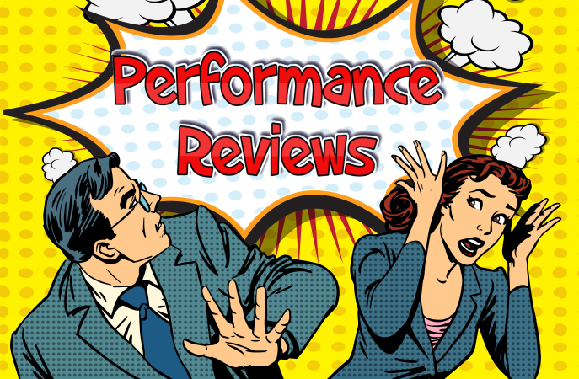
Reasons Why Employees Fear Performance Reviews
Fear of the unknown.
Fear of failure.
Fear of feedback.

Slide 11
What Is Feedback?
Appreciation
I see you. I value you. I thank you.
Coaching
Here’s how you can improve.
Evaluation
Here’s how you’re doing and where you stand compared to others, or against expectations.

Slide 12
Triggered Reactions to Feedback
Truth Triggers
You’re wrong! That’s not true!
Relationship Triggers
Who are you to tell me?!
Identity Triggers
Seriously? Are you kidding me?

Slide 13
Challenges for Receiving Feedback Well
The Challenge to SEE
Seeing what the giver means
Seeing ourselves clearly
The challenge of WE
Separating the who from the what
The Challenge of Being ME
Understanding your own feedback wiring
Cultivating a growth identity

Slide 14
SCARF
S | tatus
C | ertainty
A | utonomy
R | elationship
F | airness

Slide 17
Performance Management Isn’t…
A score― It’s a frequent, ongoing coaching conversation.
An annual meeting― It’s a development opportunity that occurs as necessary.
Bound by technology― It’s a behavioral attribute that puts the employee at the center of his or her growth.
A hammer― It’s an opportunity to use all of the tools in the toolbox.
Managing performance― It’s the leader’s responsibility to help build up and then release the enhanced performance of an employee.

Slide 18
Check Us Out
Sherry Ray Boeger, Director
Charles LaTorre, Consultant
Mary McCaslin, Office Manager
Website: www.eao.wisc.edu
Main Number: 608-263-2987

