Slide 1
Title and Total Compensation (TTC) Project
Academic Staff Assembly
Diane Blaskowski – Director of Talent Rewards
November 11, 2019

Slide 2
Agenda
01 | OVERVIEW AND MAPPING UPDATE
02 | STANDARD JOB DESCRIPTION LIBRARY
03 | PROGRESSION & PROMOTION
04 | BUSINESS TITLES
05 | All-CAMPUS FORUMS

Slide 3
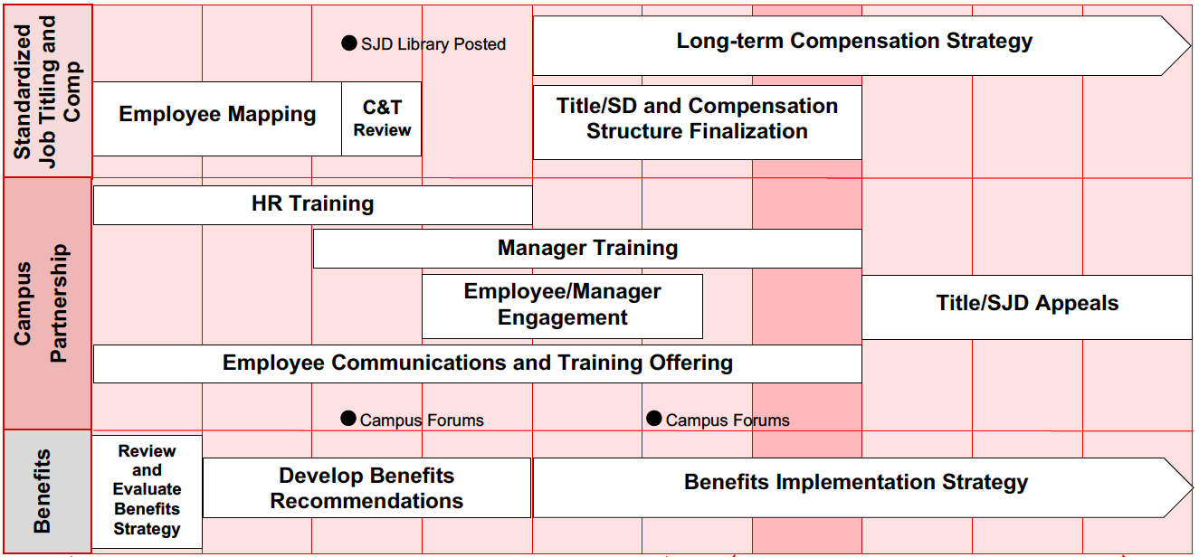
TTC Project Timeline
SEP
OCT
NOV
DEC
JAN
FEB
MAR
APR
MAY
JUN

Slide 4
Highlights
November
HR and manager training
Mapping completion by 11/15. Currently at 80%
Title and Standard Job Description (SJD) Library posted online
November All-Campus Forums
December
Position descriptions are created from the SJDs
Employee conversations begin
Spring 2020
Title and salary structure implementation
Staff receive letters with new title and salary ranges

Slide 5
Agenda
01 | OVERVIEW AND MAPPING UPDATE
02 | STANDARD JOB DESCRIPTION LIBRARY
03 | PROGRESSION & PROMOTION
04 | BUSINESS TITLES
05 | All-CAMPUS FORUMS

Slide 6
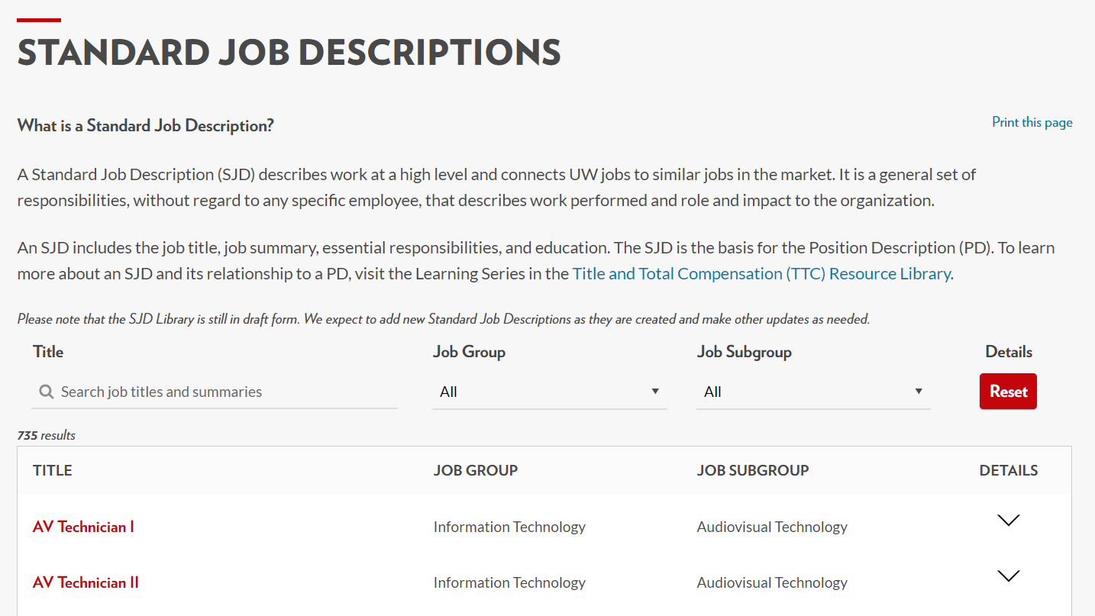
Title and Standard Job Description Library
hr.wisc.edu/standard-job-descriptions

Slide 7
Title and Standard Job Description Library
Job Title
Job Group
Sub-Group
Job Summary
Essential Job Responsibilities
Education
Posted on the TTC Project website on November 11

Slide 8
Organized by Job Group & Sub-Group
Finance
Accounting, Financial Operations, and Reporting
Bursar
Financial Planning and Budgeting
Procurement
Accountant I
Accountant II
Accountant III
Controller
Financial Manager
Financial Reporting Director
Financial Specialist I
Financial Specialist II
Financial Specialist III
Associate Bursar
Bursar
Budget Director
Budget Manager
Budget Planner I
Budget Planner II
Chief Business Officer (S/C/D)
Chief Financial Officer (Institution)
Chief Financial Officer (S/C/D)
Finance Assistant Director
Finance Director
Procurement Assistant Director
Procurement Director
Procurement Manager
Procurement Specialist I
Procurement Specialist II
Procurement Specialist III

Slide 9
Sub-Group Level

Slide 10
Academic Advisor – Today
Job Summary
Provides information, interpretation of policy, advice and counsel to students in academic departments, academic programs service areas such as financial aid, career planning and placement, registration or admissions. Advises students individually or in small group settings. May have advising responsibilities in more than one area or may have other related student services administrative duties.

Slide 11
Academic Advisor I – After Implementation

Slide 12
Academic Advisor II – After Implementation

Slide 13
Locksmith – Today
Locksmith
Job Summary
Employees in positions at this level work under close progressing to limited supervision, and through training, self-education and on-the-job experience progress towards mastery of locksmith trade knowledge and skills for the full range of locks and security systems for which the employee will be responsible. Employees apply knowledge of provisions of the Americans with Disabilities Act and applicable fire and safety codes to ensure that locks, doors and security systems comply with these regulations. Positions install, repair, replace, re-key, and adjust mechanical and electrical locks and electronic access control systems, and fabricate and install related door components and hardware.
Notes:
This could be deleted per our email exchange.

Slide 14
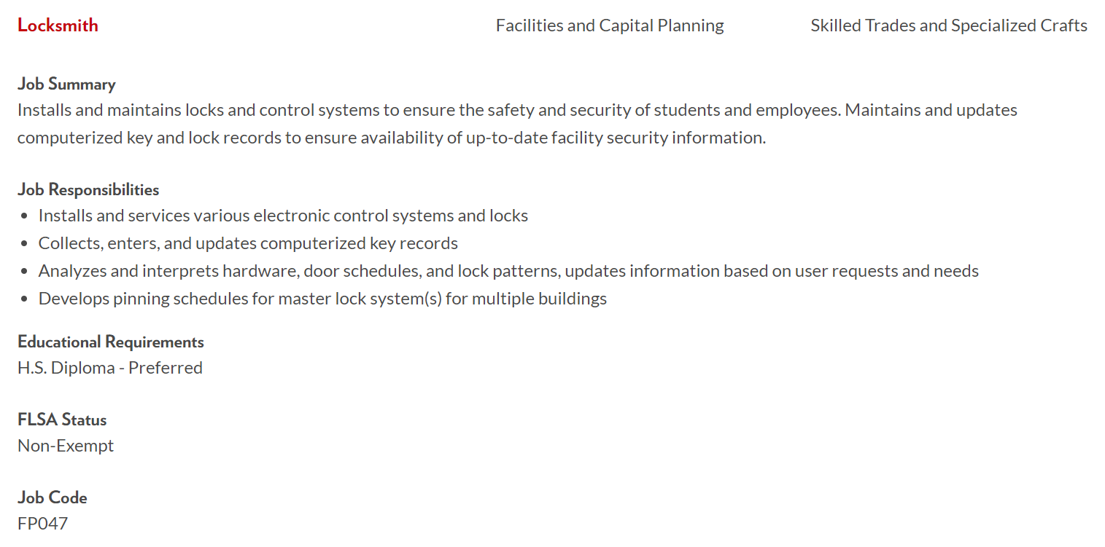
Locksmith – After Implementation

Slide 15
Administrative Program Specialist – Today
Job Summary
Provides specialized services associated in managing daily administrative activities in a variety of areas including instructional and research areas. Have greater responsibility and independence of action than the support focus provided by an administrative specialist. Work can be distinguished from a program manager in that the area is not typically recognized as a free standing activity.
May be similar to an administrative officer, but may have less direct control of policy development and are often in units smaller than the usual size of a school, college, or administrative division.
Often have expertise in the discipline area which directly affects their ability to perform their job.

Slide 16
Possibilities After Implementation
Administrative Specialist I
Administrative Specialist II
Contract Administrator
Department Administrator
Executive Assistant I
Executive Assistant II
Learning Manager
Instructional Administrator
Project Manager I
Project Manager II
Project Manager III
Training Facilitator
Training and Organizational Specialist I
Training and Organizational Specialist II
Wellness Program Manager

Slide 17
Agenda
01 | OVERVIEW AND MAPPING UPDATE
02 | STANDARD JOB DESCRIPTION LIBRARY
03 | PROGRESSION & PROMOTION
04 | BUSINESS TITLES
05 | All-CAMPUS FORUMS

Slide 18
Promotion and Progression - Today
Promotion After Year 7
Advanced/
Senior
Salary Grade 6 –
Year 7
Promotion After Year 2
Objective/
No Prefix
Salary Grade 5 –
Year 2
Year 3
Year 4
Year 5
Year 6
Hire
Entry/
Associate
Salary Grade 4 –
Year 1

Slide 19
After Implementation
Promotion
Vertical advancement to a new job
Duties focused based on work performed
Market influenced
Internal salary alignment (parity)
Not based on time in seat
Progression
Horizontal advancement within the same job
Performance driven within the same title
Market influenced
Internal salary alignment (parity)
Not based on time in seat

Slide 20
Level/Grade and Range
Salary Level/Grade (Promotion)
Salary Range (Progression)
Identifies a pay range within a salary structure. Multiple jobs can be grouped into the same level or grade.
Upper and lower limits of compensation that can apply to a given job. Typically includes a minimum, midpoint and maximum.
Grade 4
Grade 3
Minimum
Midpoint
Maximum
Grade 2
Grade 1

Slide 21
Promotion after Implementation
Promotion into
New Role
Salary Grade 5 –
Academic Advisor II
Year 1
2024
New
Job
Hire
Salary Grade 4 –
Academic Advisor I
Year 1
Year 2
Year 3
Year 4
Year 5
2020
2021
2022
2023
2024

Slide 22
Progression after Implementation
Hire
John Bascom
Salary Grade 4 –
Academic Advisor I
Year 1
Year 2
Year 3
Year 4
Year 5
2020
2021
2022
2023
2024

Slide 23
Progression after Implementation
Hire
Bucky Badger
Salary Grade 5 –
Academic Advisor II
Year 1
Year 2
Year 4
Year 8
Year 10
Year 12
Hire
John Bascom
Salary Grade 4 –
Academic Advisor I
Year 1
Year 2
Year 4
Year 5
Year 6
Year 9
Year 11

Slide 24
Pay Progression Components
Base Adjustments
Pay plan
Performance
Market movements/review
Parity
Retention-Based
Lump Adjustments
Performance
Supplemental lump sum
Retention-Based
Awards
Add-ons

Slide 25
Changes After Implementation
What Is Changing?
What Stays the Same?
Job framework
Salary structure
Working titles (business titles)
Position descriptions
Salary administration guidelines
Job duties
Base pay
Reporting relationships
Performance and development goals
Employee category
Statutory benefits
Sick Leave conversion

Slide 26
Agenda
01 | OVERVIEW AND MAPPING UPDATE
02 | STANDARD JOB DESCRIPTION LIBRARY
03 | PROGRESSION & PROMOTION
04 | BUSINESS TITLES
05 | All-CAMPUS FORUMS

Slide 27
What is a Business Title (Working Title)?
A business title provides more description to an employee’s assigned official job title (title of record)
A business title provides more specific detail about an individual position within the organization or the type of work performed
Business titles replace working titles
Notes:
ok

Slide 28
Where Can I Use a Business Title?
UW Directory
Department website
Name badge
Business cards
Email signature
Internal and external communications
Office signage
Stationery
Vacancy announcement
Business titles do not change an employee’s title of record or assigned salary range

Slide 29
Business Title Guidelines
A Business Title Should:
Provide a more specific description of your job to facilitate business communications
Add clarity to the job function, group and classification assignment in describing the individual job
Align with professional and industry practice
Align with other working titles within a job group or work unit
Be 30 characters or less
A Business Title Cannot:
Duplicate a title of record
Misrepresent the university or the authority of a position
Use words typically associated with institutional officers
Steps to Identify a Business Title:
Check the SJD Library to confirm the title does not exist
Talk with your Supervisor
Confirm with your HR office if you have questions
Notes:
ok

Slide 30
Business Title Examples
Recreation Program Coordinator
Possible Title: Adopts the business title of Coordinator of Competitive Sports to specify their program area
Not Acceptable Title: A business title of Director of Recreation would not work because the title misrepresents their level of authority
Outreach Specialist
Possible Title: A business title of Outreach Specialist-Senior would work because it is not a current title and reflects the employee’s experience
Not Acceptable Title: A business title of Extension Specialist would not work because that is an existing title of record
Sponsored Programs, Grants & Contracts Compliance Officer
Possible Title: A business title of Research Administration Compliance Specialist might work because it defines an area within the title.
Not Acceptable Title: A business title of Compliance Manager would not work because that is an existing title of record
Notes:
ok

Slide 31
Agenda
01 | OVERVIEW AND MAPPING UPDATE
02 | STANDARD JOB DESCRIPTION LIBRARY
03 | PROGRESSION & PROMOTION
04 | BUSINESS TITLES
05 | All-CAMPUS FORUMS

Slide 32
November All-Campus Forums
Dates | Location | Event Time
11/12/19 | Union South Multilingual | 9 – 10:30 a.m.
11/12/19 | Gordon Dining & Event Center English Only | 1 – 2:30 p.m.
11/13/19 | Health Science Learning Center (Multilingual) – Late Night | 11 p.m. – 12:30 a.m.
11/14/19 | Health Science Learning Center English Only | 11 a.m. – 12:30 p.m.
11/20/19 | Online Forum English Only | 11:30 a.m. – 1 p.m.
Notes:
MBG

Slide 33
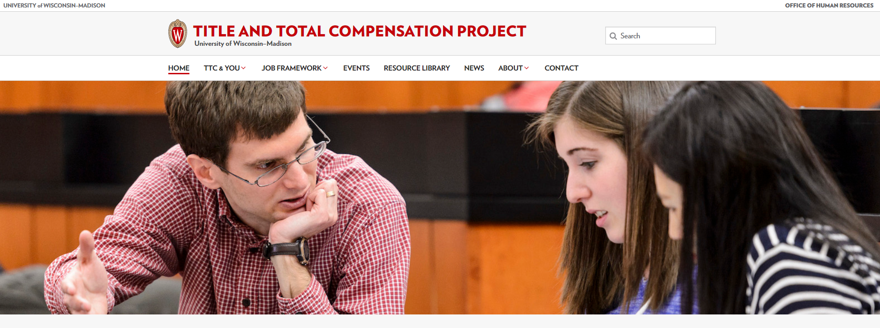
TTC Website
go.wisc.edu/TTCProject

Slide 34
Questions
Website:
go.wisc.edu/ttcproject
Email: ttcstudy@ohr.wisc.edu

