Slide 1
EXPORT CONTROLS AT UW-MADISON
Ben Griffiths
Senior University Legal Counsel
Tom Demke
Export Control Officer
Bethany Nelson
Export Control Coordinator

Slide 2
WHAT ARE EXPORT CONTROLS?
Export Controls are a series of U.S. laws and regulations that control the export of information, goods and services from the United States to foreign countries, or to the release of controlled technology to foreign persons within the U.S.
These laws can apply to UW research activities, including activities here on campus when foreign persons are involved.
Other related laws control financial interactions with foreign governments and persons.
Violation of these laws and regulations can result in severe civil and criminal penalties to individuals and/or to the institution.

Slide 3
WHEN MIGHT EXPORT CONTROLS APPLY AT THE UW?
Typical scenarios at the UW that can involve export controls include:
Research with pathogenic/toxic materials
Satellite and space-related research
Shipment of samples and equipment for overseas projects
Proprietary industry-sponsored research
Foreign travel
ALSO – employment-based visa applications require export control certification based on assessment of visa holder’s activities.

Slide 4
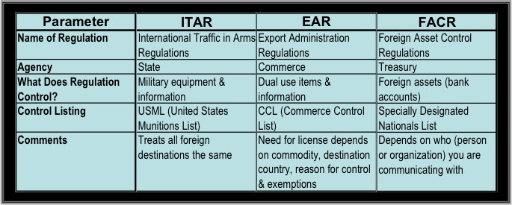
PRIMARY EXPORT CONTROL LAWS
ITAR primarily serves national security goals; EAR serves national security, foreign policy and economic and technological competitiveness goals.

Slide 5
EXCEPTION FOR FUNDAMENTAL RESEARCH
Export controls do not apply to information arising from “fundamental research.”
“Fundamental research” means basic and applied research in science and engineering, where the resulting information is ordinarily published and shared broadly with the scientific community.
“Fundamental research” is distinguished from proprietary research and from industrial product development, the results of which ordinarily are restricted for proprietary reasons or specific national security reasons.
UW policies on publication and ownership of data keep most research at the UW within the fundamental research exception.
However, export controls can apply to fundamental research if the UW uses proprietary or sensitive information or technology supplied by third parties in some aspect of the research.

Slide 6
EXPORT LICENSING
Export licenses for shipment of tangible materials overseas can be obtained relatively easily and quickly.
Licenses from Commerce and State typically < 2 months
“Deemed export” licenses covering transmission of controlled information within the U.S. can be obtained, but are more complicated and will entail significant time and effort.
License exceptions are sometimes available.

Slide 7
OTHER RELATED CONTROLS
Other related restrictions:
USDA/CDC Select Agents (also covered by the EAR)
DURC – Dual Use Research of Concern
“Sensitive but unclassified” information
Homeland Security “Critical Infrastructure Information” Program
Trade embargoes (particularly Iran, North Korea, Sudan, Syria)
Department of Treasury Office of Foreign Asset Controls “specially designated nationals” list and similar lists of individuals and entities with whom financial and export transactions are restricted.

Slide 8
UW’S EXPORT CONTROL COMPLIANCE PROGRAM
Master campus export control compliance plan established
https://kb.wisc.edu/gsadminkb/page.php?id=35039
Campus plan follows a Dept. of Commerce template for compliance programs
Website: http://research.wisc.edu/respolcomp/exportcontrol/
Staff
Tom Demke - Export Control Officer
Bethany Nelson – Export Control Coordinator
Ben Griffiths – Legal Counsel

Slide 9
UW’S EXPORT CONTROL COMPLIANCE PROGRAM
Impact of Export Controls
Export controls could have an affect on:
Research – Project selection and management
Staff – Selection of international staff / students, management and work assignments
Information and data – What can be published or discussed
Travel – Destination and what is taken
Shipping – What we ship and destination
Collaborators / Vendors – Who, what organization and where
Services – Type of service, who conducts the service and recipient
When do we need export licenses?

Slide 10
UW’S EXPORT CONTROL COMPLIANCE PROGRAM
Project & Transaction Assessment
WISPER Screening Tool – in place since June 10, 2013
Project Assessment Form - available to determine when a license is needed
Visa Export Control Certification - For H-1B & O-1 applications; since Feb 2011
Visual Compliance Restricted Party Screening Service - used for screening visas applications, project awards & purchasing transactions
Foreign vendor screening conducted with assistance of Business Services
Outgoing International MTAs – reviews started in 2015 in conjunction w/ OIP

Slide 11
UW’S EXPORT CONTROL COMPLIANCE PROGRAM
Main Areas of Concern
J-1 Visa Visiting Scholars – could implement H1-B/O-1 process for J-1 scholars
International Shipping – no centralized shipping process or vendor; could partner w/ key shippers (UPS, FedEx)
International Travel – Concur booking system is now required
Foreign Students (working in research labs) – very difficult to screen prior to placement in labs

Slide 12
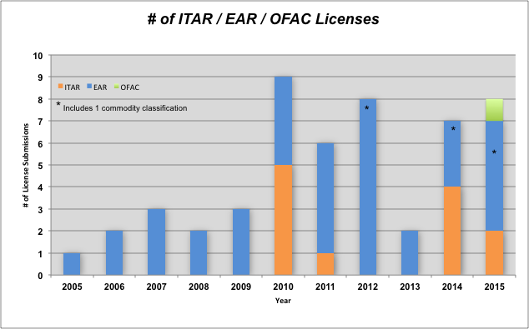
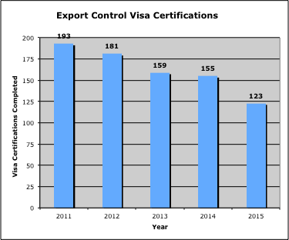
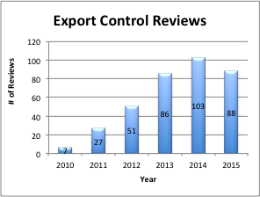
UW EXPORT CONTROL METRICS
Average Approval Time:
ITAR - 14 days
EAR - 48 days
OFAC - ??; first license still in review (> 191 days)
* All metrics current through October 28, 2015

Slide 13
UW EXPORT CONTROL METRICS
Voluntary Self-Disclosures
AERI import license not used for shipment (DDTC, Jul 2011)
Thermal imaging camera not returned from India within timeframe noted in license (BIS, Oct 2012)
AES filing not submitted for equipment to India (Census Bureau, Jan 2013)
Chemistry software uploaded to Iran (OFAC, Jan 2014)
Vesicular stomatitis virus shipped to India w/o a license (BIS, Mar 2015)
Awaiting final response from BIS

Slide 14
CONTACT INFO
Tom Demke
Export Control Officer
525 Atmospheric Oceanic and Space Sciences Building
262-8659
tom.demke@ssec.wisc.edu
Bethany Nelson
Export Control Coordinator
519 Atmospheric Oceanic and Space Sciences Building
261-1128
bcnelson2@grad.wisc.edu
Ben Griffiths
Senior University Legal Counsel
Office of Administrative Legal Services
361 Bascom Hall
263-7400
bgriffiths@vc.wisc.edu

